Slide 1
Another way to think of an antialiased slanted line is as a slanted parallelogram
Y
P2
P1
X

Slide 2
Another way to think of an antialiased slanted line is as a slanted parallelogram
Y
P2
P1
X

Slide 3
Another way to think of an antialiased slanted line is as a slanted parallelogram
Y
P2
P1
X

Slide 4
Replace the parallelogram in each column by a square with the same vertical extent along the centerline of the column.
Y
P2
P1
X

Slide 5
Replace the parallelogram in each column by a square with the same vertical extent along the centerline of the column.
Y
P2
P1
X

Slide 6
Then color each pixel by the fraction of the square that overlaps it.
Y
P2
P1
X

Slide 7
Then color each pixel by the fraction of the square that overlaps it. For an orange line on a blue background, each square has orange and blue fractions.
Y
P2
P1
X

Slide 8
Then color each pixel by the fraction of the square that overlaps it. For an orange line on a blue background, each square has orange and blue fractions.
Y
P2
P1
X

Slide 9
How could this code be revised to account for the blue background?
float line_color[3] = {1., .5, 0.}; // orange
for (x = xstart; x < xstop; ++x) { // this works only when x2 > x1
iy = floor(y);
if (y > iy + .5) {
ofac = y - (iy + .5);
ffac = 1. - ofac;
r = ffac*line_color[0];
g = ffac*line_color[1];
b = ffac*line_color[2];
set_pixel(x, iy, r, g, b);
r = ofac*line_color[0];
g = ofac*line_color[1];
b = ofac*line_color[2];
set_pixel(x, iy+1, r, g, b);
}
else { // continue with y <= iy + .5 case
ofac = iy + .5 - y; ...

Slide 10
How could this code be revised to account for the blue background?
float line_color[4] = {1., .5, 0., 1.}, background_color = {.0, .2, .7};
for (x = xstart; x < xstop; ++x) { // this works only when x2 > x1
iy = floor(y);
if (y > iy + .5) {
ofac = y - (iy + .5);
ffac = 1. - ofac;
r = ffac*line_color[0] + ofac*background_color[0;
g = ffac*line_color[1] + ofac*background_color[0;
b = ffac*line_color[2] + ofac*background_color[0];
set_pixel(x, iy, r, g, b);
r = ofac*line_color[0] + ffac*background_color[0];
g = ofac*line_color[1] + ffac*background_color[1];
b = ofac*line_color[2] + ffac*background_color[2];
set_pixel(x, iy+1, r, g, b);
}
else { // continue with y <= iy + .5 case
ofac = iy + .5 - y; ...

Slide 11
Alpha compositing adds a transparent object over a background.
void set_pixel_alpha(int x, int y, double r, double g, double b, double a) {
int index;
float transparency = 1 - a;
if (x >= 0 && x < width && y >= 0 && y < height) {
index = 3*(x + width*y);
image[index ] = (unsigned char)(255*a*r + transparency*(float)image[index ]);
image[index+1] = (unsigned char)(255*a*g + transparency*(float)image[index+1]);
image[index+2] = (unsigned char)(255*a*b + transparency*(float)image[index+2]);
}
}

Slide 12
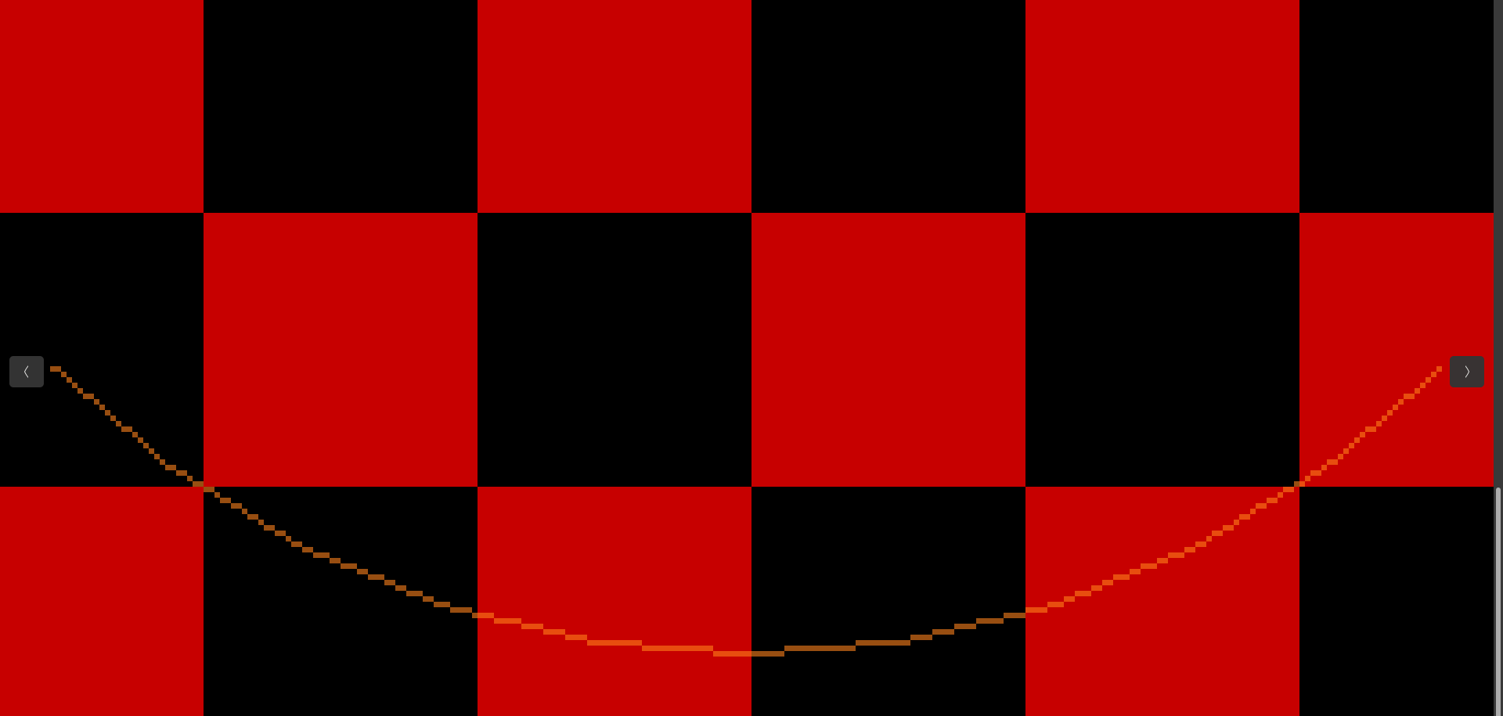
Image from Transparent_Colored_Line_x.cpp with loop: for (x = xstart; x < xstop; ++x)

Slide 13
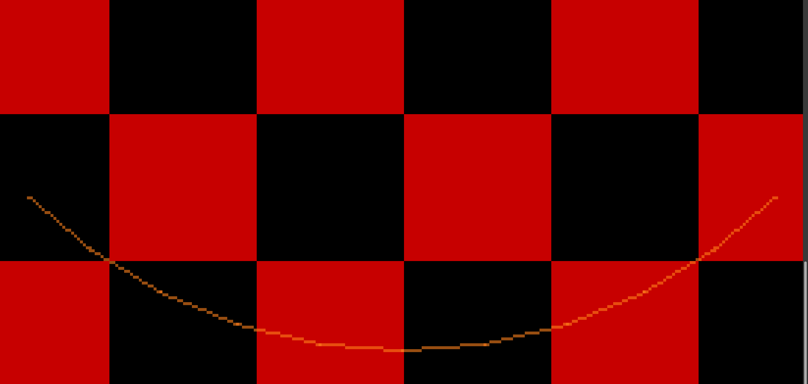
Image from Transparent_Colored_Line_x.cpp with loop: for (x = xstart; x <= xstop; ++x)

Slide 14
Why do some columns with an endpoint have two transparent pixels instead of one bright pixel?
P1
B
A
P2
P3
xc

Slide 15
For a transparent anti-aliased line, each orange square should be transparent, so that it contributes less orange, and blue shows through.
Y
P2
P1
X

Slide 16
For a transparent anti-aliased line, each orange square should be transparent, so that it contributes less orange, and blue shows through.
Y
P2
P1
X

Slide 17
How should we compute the opacity alpha for compositing?
Y
P2
P1
X

Slide 18
for (x = xstart; x < xstop; ++x) { // this works only when x2 > x1
iy = floor(y);
if (y > iy + .5) {
ofac = y - (iy + .5);
ffac = 1. - ofac;
r = line_color[0];
g = line_color[1];
b = line_color[2];
a = ffac*line_color[3];
set_pixel_alpha(x, iy, r, g, b, a);
r = line_color[0];
g = line_color[1];
b = line_color[2];
a = ofac*line_color[3];
set_pixel_alpha(x, iy+1, r, g, b, a);
}
else {
ofac = iy + .5 - y; // continue with the y <= iy + .5 case

Slide 19
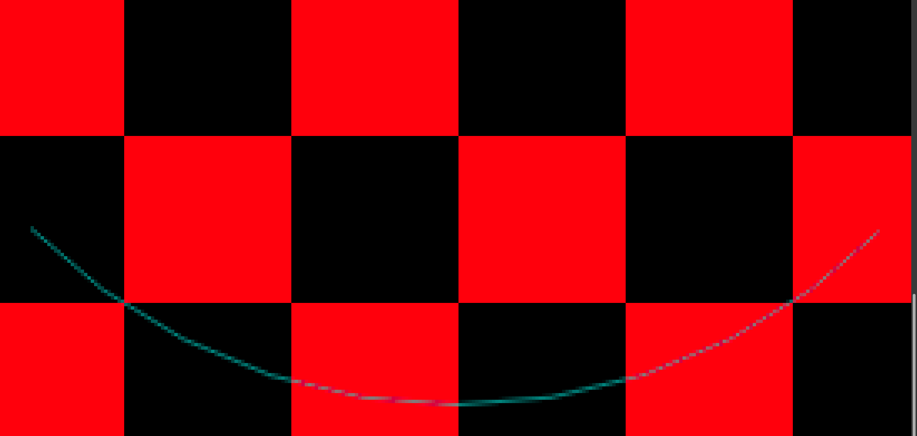
Transparent_Colored_antialiasedlines_x.cpp no gamma; loop: for (x = xstart; x < xstop; ++x)

Slide 20
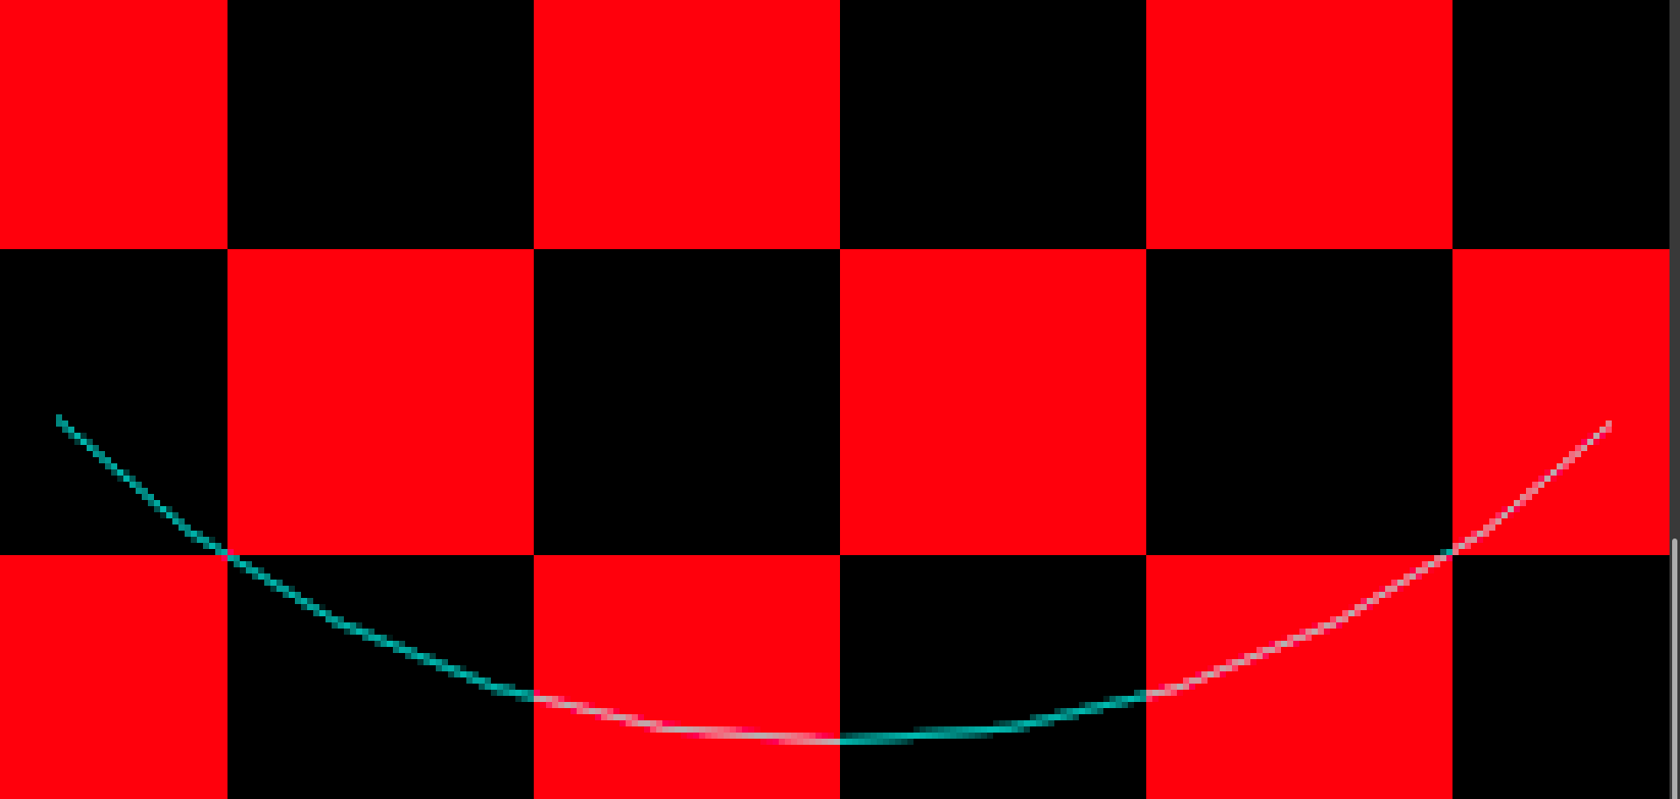
Transparent_Colored_antialiasedlines_x.cpp gamma; loop: for (x = xstart; x < xstop; ++x)

Slide 21
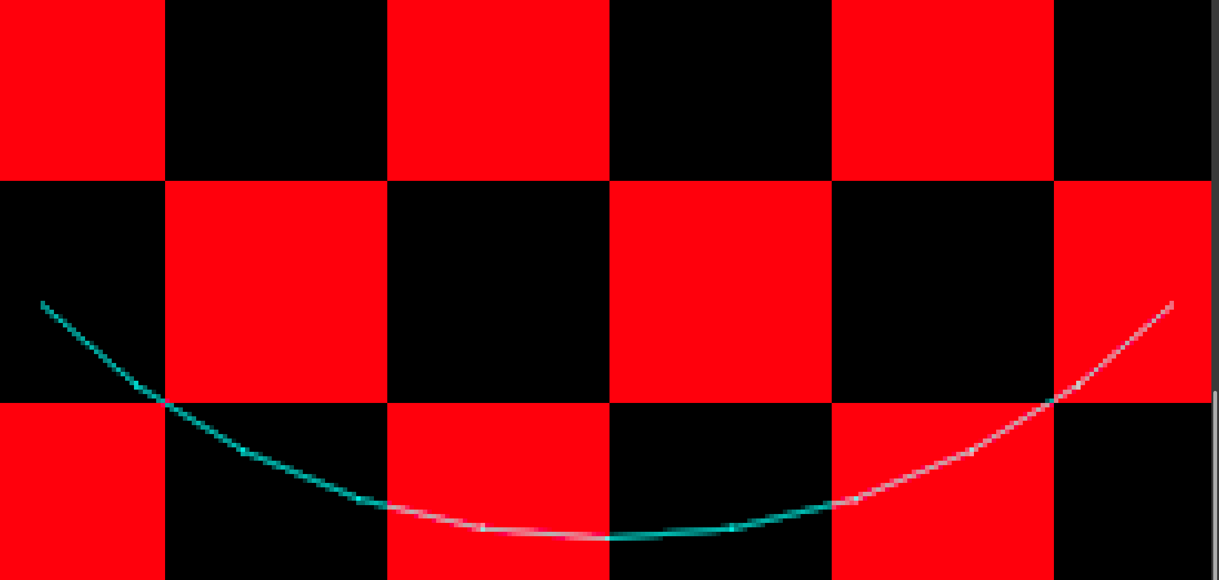
Transparent_Colored_antialiasedlines_x.cpp gamma; loop: for (x = xstart; x <= xstop; ++x)

Slide 22
Replace the parallelogram in each column by a square with the same vertical extent along the centerline of the column.
Y
P2
P1
X

Slide 23
Is the area the same in each pixel? In pixel column A, the rectangles and the trapezoids have the same areas. But in column B there are extra triangles.
Y
P2
P1
X
A
B

Slide 24
In each column, the area of the parallelogram is the same as the area of the
square, which is 1, whether you account for the extra triangles or not.
Y
P2
de
P1
X
A
B

Slide 25
In each column, the area of the parallelogram is the same as the area of the
square, which is 1. So the total blue area in the 5 columns is 5.
Y
P2
P1
X

Slide 26
The total blue area in the 5 columns is 5. The black line has length about 5.2 .
Y
X

Slide 27
The total blue area in the 5 columns is 5. The black line has length 5.
Y
X

Slide 28
The total blue area in the 5 columns is 5. The black line has length 5 sqrt(2) = 7.07 . So more slanted lines have less blue per unit length, and seem dimmer.
Y
X

Slide 29
The thickness of this parallelogram, measured perpendicular to its slanted sides, is the length of AB = .5*sqrt(2) = .707 , so the slated line appears thinner.
Y
A
X
C
B

Slide 30
The slanted parallelogram appears thinner and dimmer than this blue rectangle with thickness 1.
Y
X

Slide 31
Here is a slanted parallelogram with thickness less than 1, which looks dim.
Y
X

Slide 32
Solution: always use a parallelogram of thickness 1.
Y
X

Slide 33
Triangles ABC and DEF have the same shape, so the length of edge BC is m and the length of AC is d = sqrt(1² + m²).
Y
A
1
d
m
B
d
F
C
m
D
1
E
X

Slide 34
The length of AC is d = sqrt(1² + m²).
Move the center line up and down by d/2 to make the parallelogram.
Y
A
d
d/2
C
d/2
X

Slide 35
Move the center line up and down by d/2 to make the parallelogram.
Then compute the blue area inside each pixel, including the triangles.
Y
A
d
d/2
C
d/2
X

Slide 36
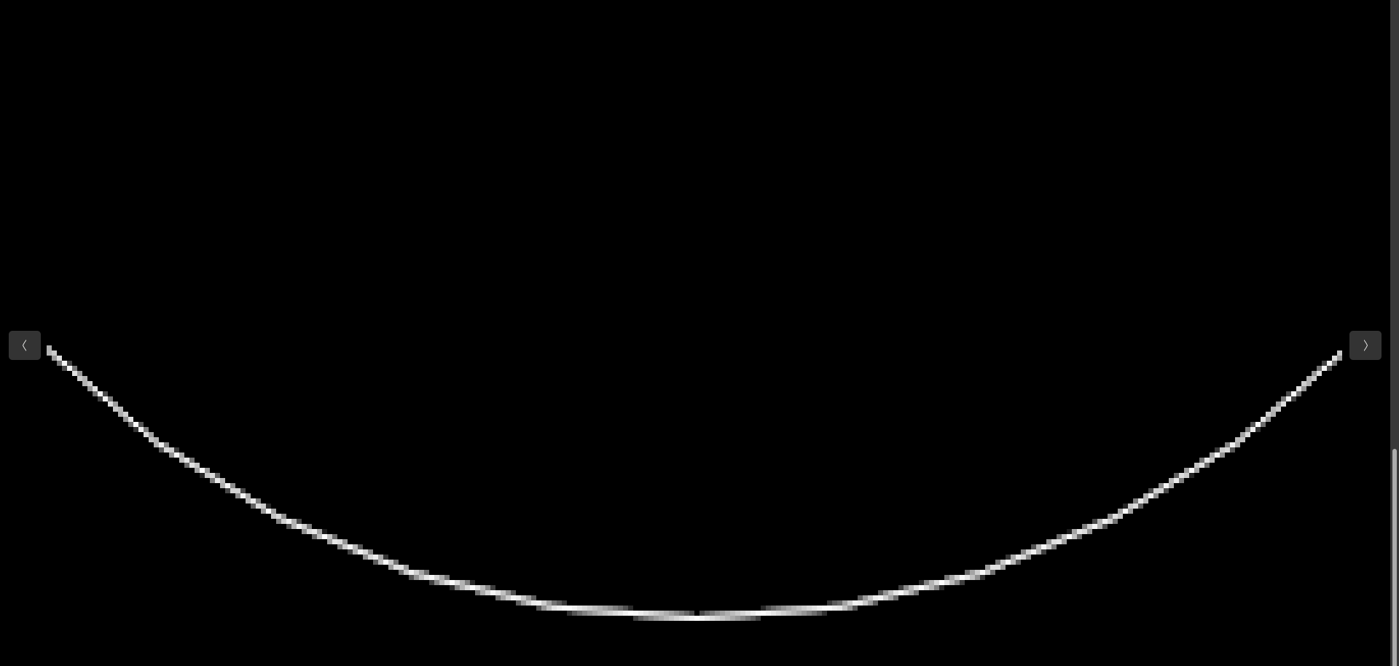
BMP image produced by AntialiasedLines_x.cpp Now the dark sections are gone. But the steeper parts are dimmer.

Slide 37
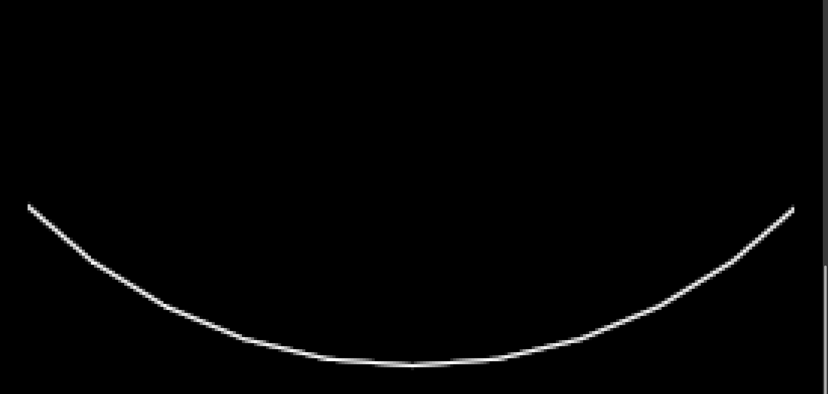
Image produced by WideAntialiasedLines_x.cpp Now the steeper parts are as bright as the less steep ones.

Slide 38
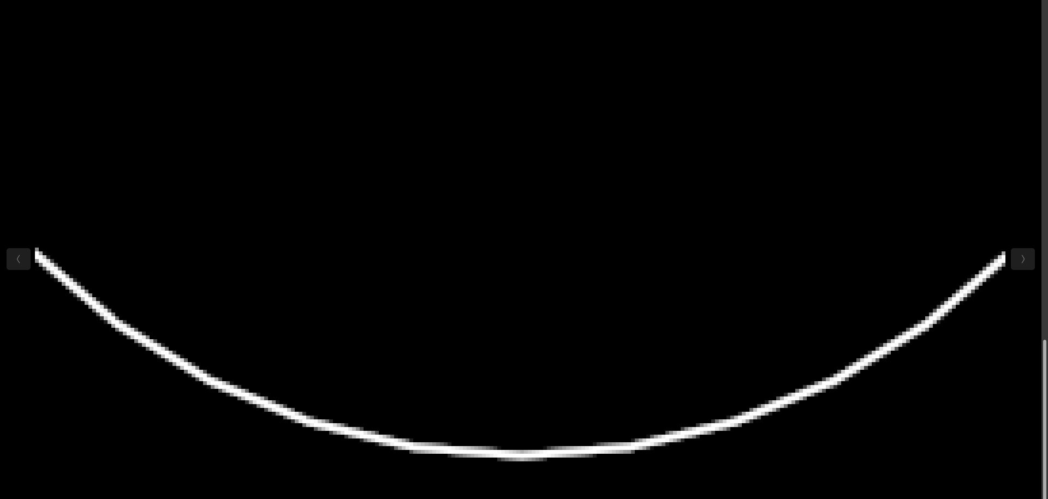
Image produced by WideAntialiasedLines_x.cpp This method can draw lines of any width. This one has width 2.

Slide 39
Quiz 1
Describe the differences between 2d and WebGL canvas contexts:
a) In capabilities.
b) In coordinate systems.
c) In number ranges used in color specifications.

Slide 40
Drawing on an HTML canvas
<!DOCTYPE html>
<html lang="en">
<head>
<meta charset="utf-8" />
<title>Draw a blue rectangle (canvas version)</title>
</head>
<body onload="main()">
<canvas id="example" width="400" height="400">
Please use a browser that supports "canvas"
</canvas>
<script src="DrawRectangle.js"></script>
</body>
</html>

Slide 41
JavaScript file DrawRectagle.js
// DrawRectngle.js (c) 2012 matsuda
function main() {
// Retrieve <canvas> element
var canvas = document.getElementById('example');
if (!canvas) {
console.log('Failed to retrieve the <canvas> element');
return false;
}
// Get the rendering context for 2DCG
var ctx = canvas.getContext('2d');
// Draw a blue rectangle
ctx.fillStyle = 'rgba(0, 0, 255, 1.0)'; // Set color to blue
ctx.fillRect(120, 10, 150, 150); // Fill a rectangle with the color
}

Slide 42
Using rectangles of size 5 by 5, draw orange and blue dots at different positions on the screen.
Download and modify DrawRectangle.html and DrawRectangle.js .

Slide 43
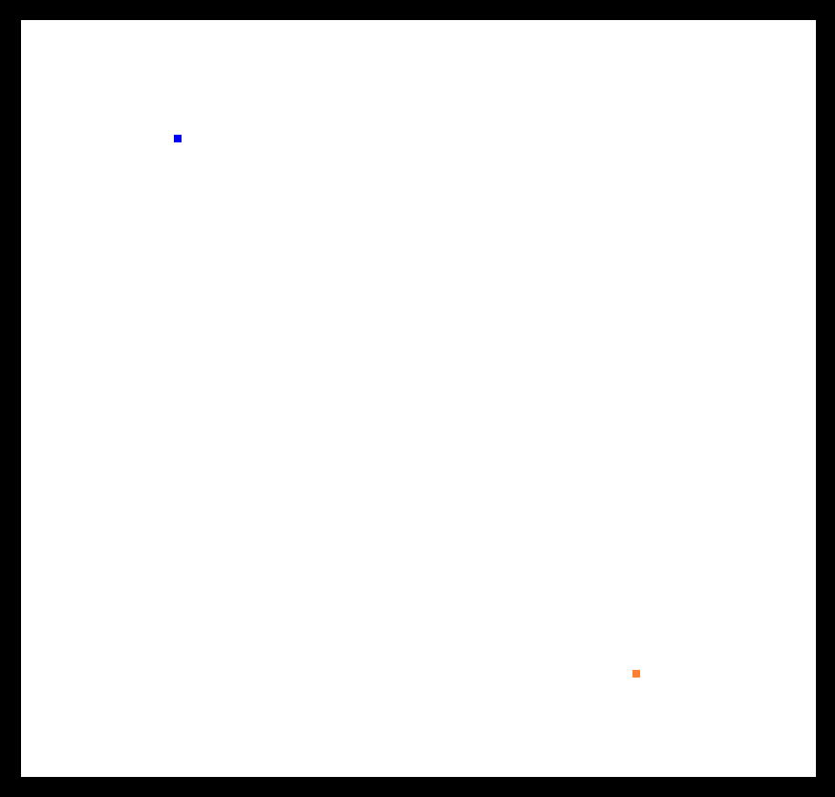
Using rectangles of size 5 by 5, draw orange and blue dots at different positions on the screen.
Download and modify DrawRectangle.html and DrawRectangle.js .

